Slide 1
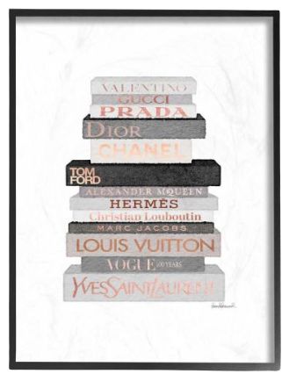
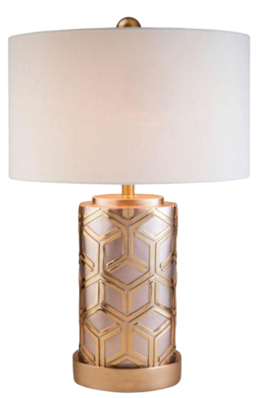
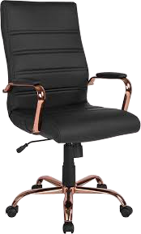
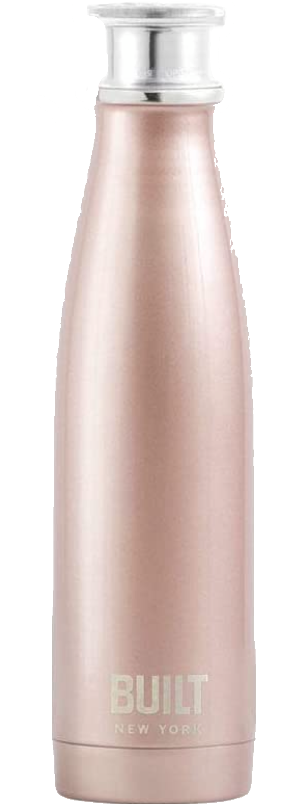
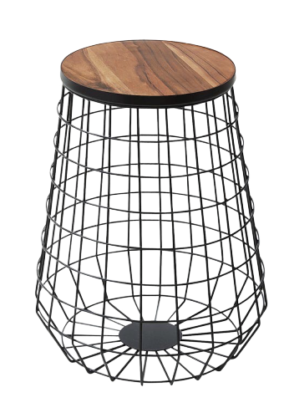
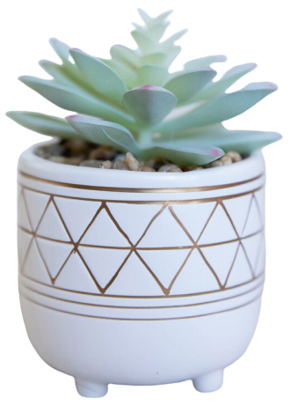
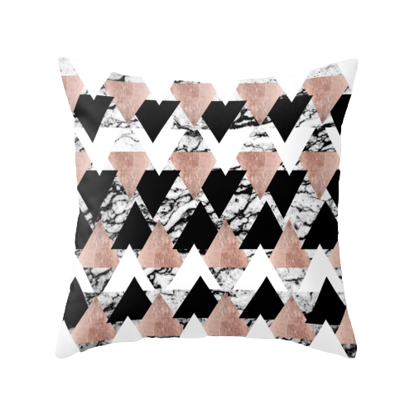
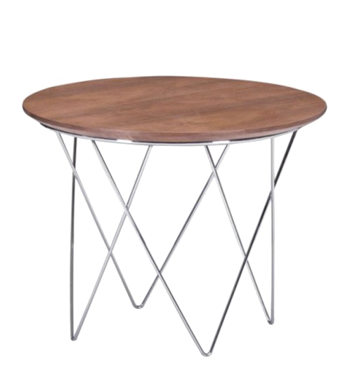
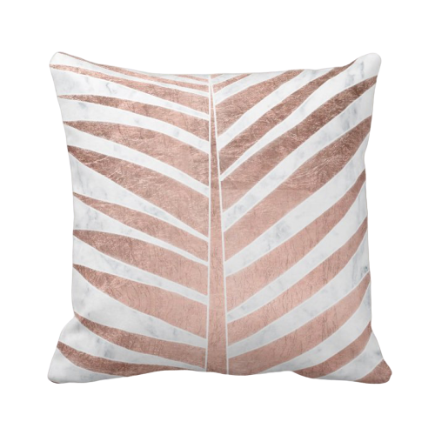
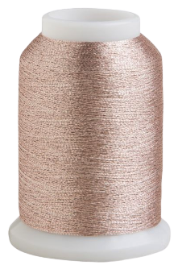
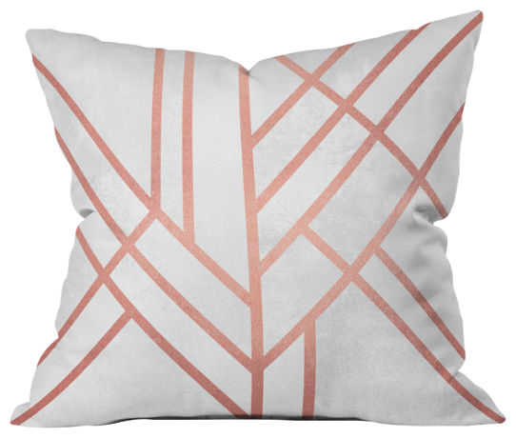
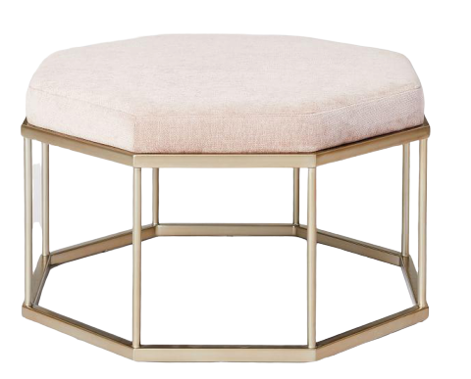
WORD WALL
Aa Bb Cc Dd Ee Ff
Gg Hh Ii Jj Kk Ll Mm Nn Oo Pp Qq Rr Ss Tt Uu Vv Ww Xx Yy Zz
Click on a letter to see your word wall words.

Slide 2
WORD WALL
Aa
Bb
a
about
after
again
all
always
also
and
animal
another
answer
any
are
around
as
ask
at
ate
away
baby
back
be
because
been
before
big
birthday
black
book
both
boy
bring
brother
brown
but
by
blue
Click on the WORD WALL sign to return home .

Slide 3
WORD WALL
Cc
Dd
call
called
came
can
change
color
come
could
day
dear
did
different
dime
do
does
don’t
door
down
Click on the WORD WALL sign to return home .

Slide 4
WORD WALL
Ee
Ff
each
eat
eight
eleven
end
even
ever
every
everyone
everywhere
family
favorite
find
first
fly
follow
food
farm
found
four
friend
from
full
funny
Click on the WORD WALL sign to return home .

Slide 5
WORD WALL
Gg
Hh
get
give
go
gone
good
got
grade
great
green
grew
grows
had
hand
happy
has
have
he
head
help
her
here
him
his
home
hour
house
how
Click on the WORD WALL sign to return home .

Slide 6
WORD WALL
Ii
Jj
I
if
in
into
is
it
jump
just
Click on the WORD WALL sign to return home .

Slide 7
WORD WALL
Kk
Ll
Kind
kindergarten
know
land
large
learn
letter
life
like
line
little
live
long
look
love
Click on the WORD WALL sign to return home .

Slide 8
WORD WALL
Mm
Nn
made
make
man
many
may
me
means
men
more
most
mother
move
Mr.
Mrs.
much
must
my
name
need
new
next
nice
nickel
night
no
not
nothing
now
number
Click on the WORD WALL sign to return home .

Slide 9
WORD WALL
Oo
Pp
of
off
oh
oil
old
on
once
one
only
open
or
orange
other
our
out
over
page
part
people
picture
pink
place
play
please
point
pretty
purple
put
Click on the WORD WALL sign to return home .

Slide 10
WORD WALL
Qq
Rr
quiet
quick
quarter
read
red
right
Click on the WORD WALL sign to return home .

Slide 11
WORD WALL
Ss
Tt
said
same
saw
say
school
see
sentence
set
seven
she
Should
show
sit
six
so
some
sound
spell
still
study
such
take
talk
teacher
tell
ten
than
thank
that
the
their
there
then
these
they
thing
think
this
those
though
thought
three
through
time
To
today
together
too
took
try
turn
twelve
two
Click on the WORD WALL sign to return home .

Slide 12
WORD WALL
Uu
Vv
under
up
us
use
very
vine
Click on the WORD WALL sign to return home .

Slide 13
WORD WALL
Ww
Xx Yy Zz
walk
want
was
water
way
welcome
well
went
were
what
when
where which
white
who
why
will
won
word
work
world
would
write
writing
years
yes
you
your
you’re
you’ve
yellow
zero
zoo
Click on the WORD WALL sign to return home .

